Slide 2
1
DATA ANALYSIS

Slide 3
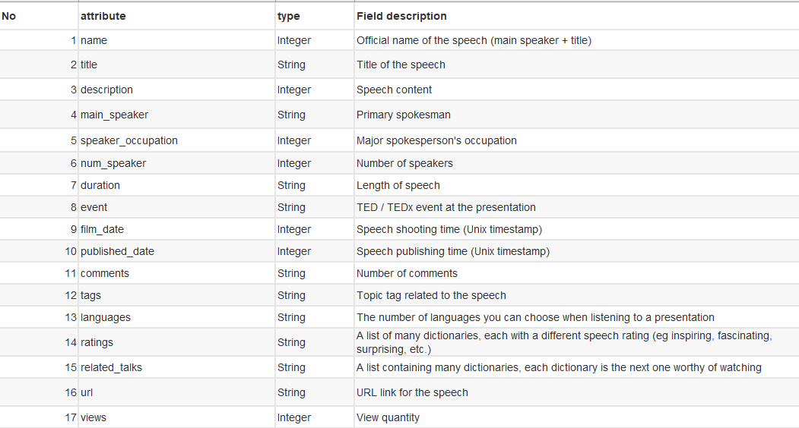
DATASET
The data set is a
2540 * 17 data set.
This diagram shows the meaning of every columns.

Slide 4
RELATION
As we can see from the heat map, the comments attribute has the most relevance to views, followed by languages.

Slide 5
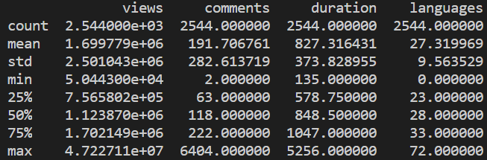
OVERALL ANALYSIS
The maximum viewing volume is 47,227,110
The minimum is 50,443
The average is 1,699,779
Undoubtably,
every video is very popular.

Slide 6
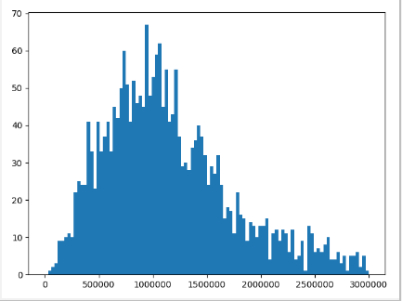
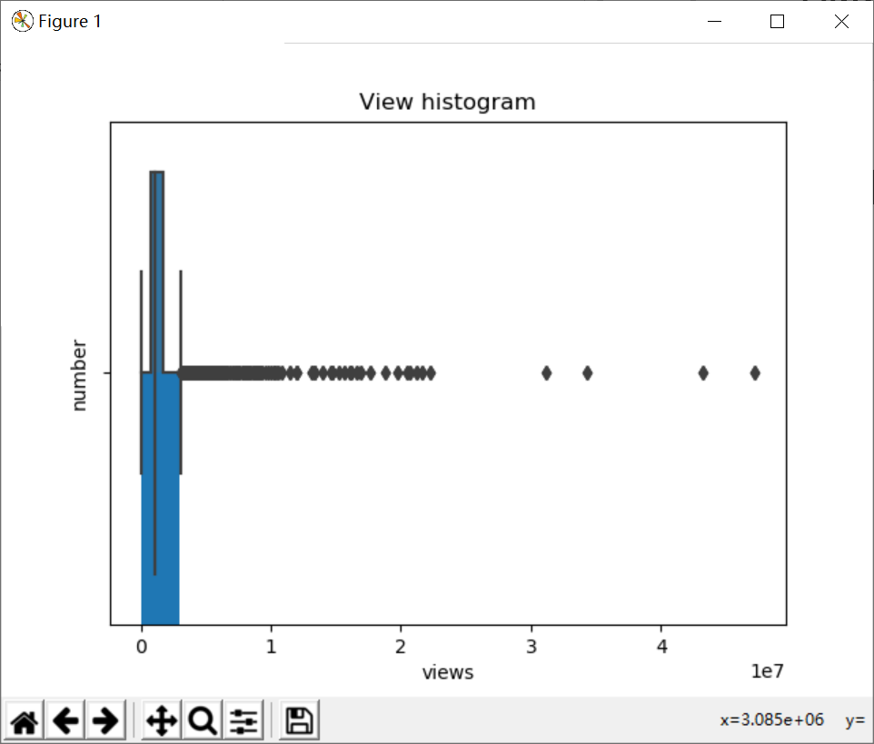
VIEW VOLUME

Slide 7
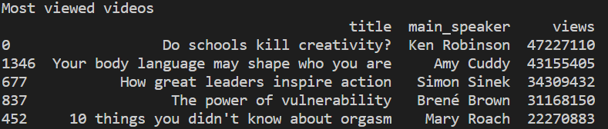
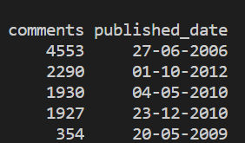
MOST VIEWED 5 TALKS

Slide 8
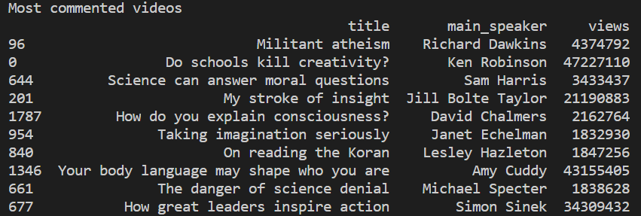
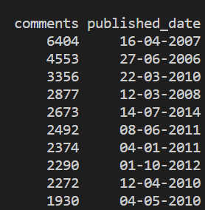
MOST COMMENTED 10 TALKS

Slide 9
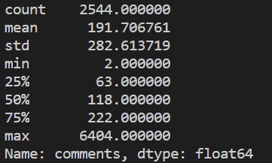
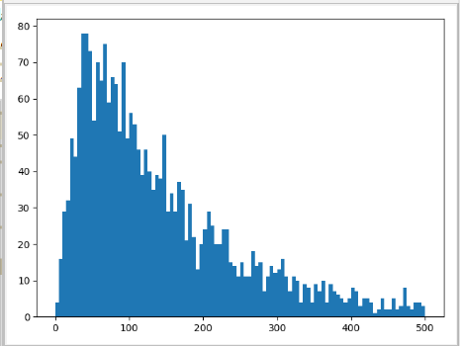
Most commented talks
The maximum comments is 6404
The minimum is 2
The average is 192
There is a big difference between them.

Slide 10
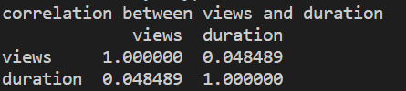
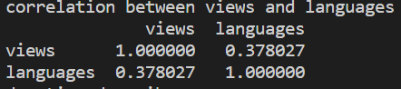
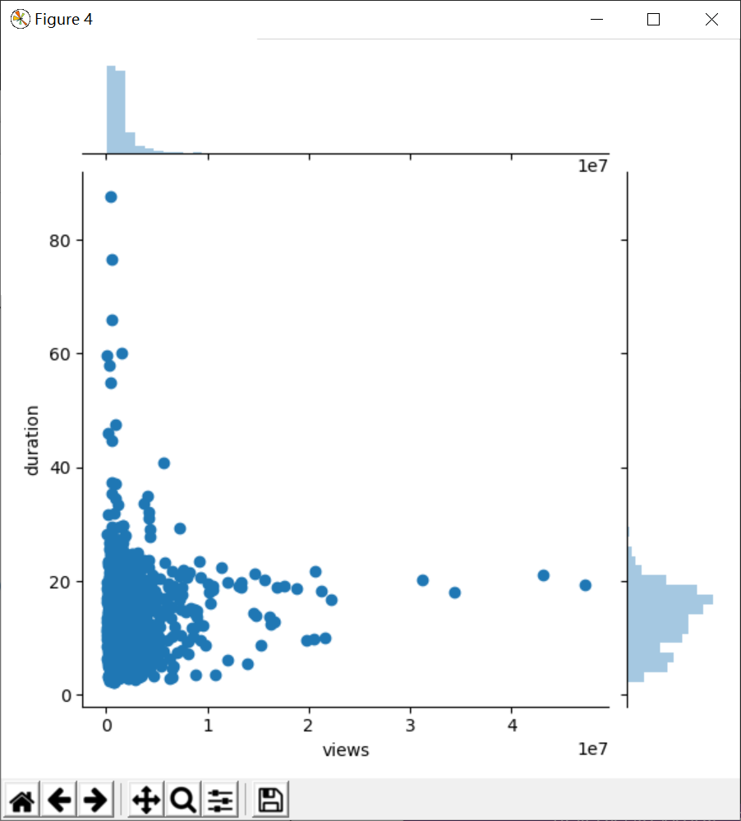
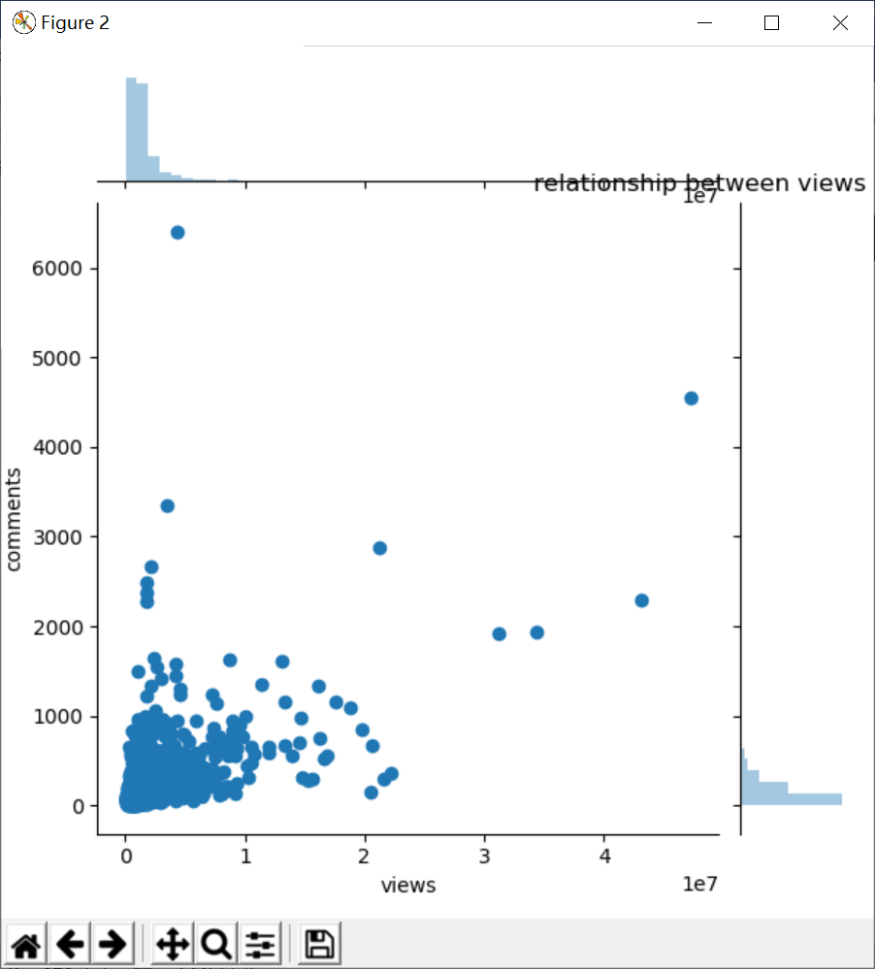
RELATIONS

Slide 11
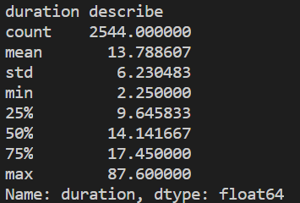
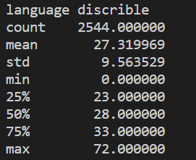
DURATION & LANGUAGE

Slide 12
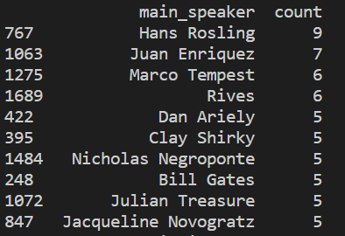
PERSONS SPEAK MOST

Slide 13
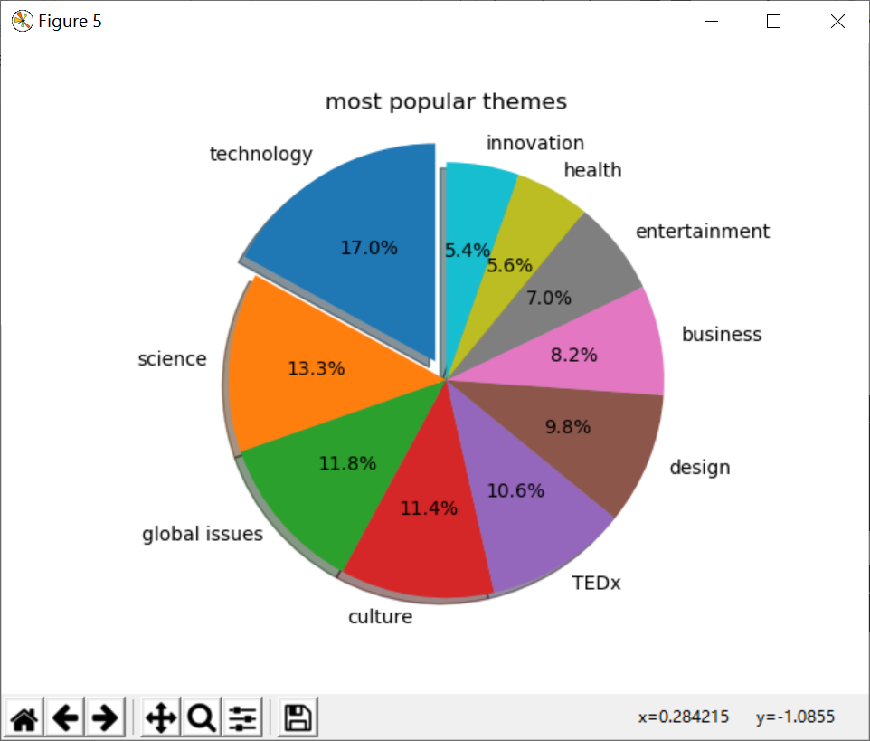
MOST POPULAR THEMES
Technology,
science,
global issues
are the most popular themes

Slide 14
2
MACHINE LEARNING

Slide 15
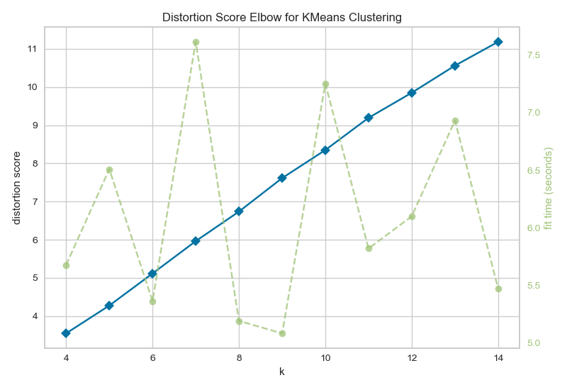
UNSUPERVISED LEARNING - CLUSTERING
Find the Most Suitable K Value
We use the Elbow Method to calculate the K values in the range 4 - 15 to get the Distortion Score and Fit Time for each K value.

Slide 16
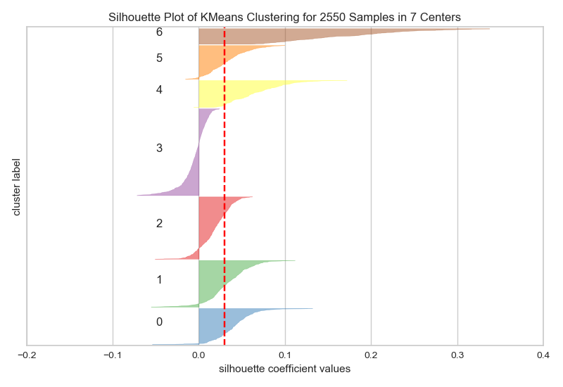
UNSUPERVISED LEARNING - CLUSTERING
Do the cluster &
Calculate the Sihouette Value
The data items classified into 7 categories, the data classified into the 7th item is more accurate, and the value of the 4th type data has a larger negative number, and the result is not good.

Slide 17
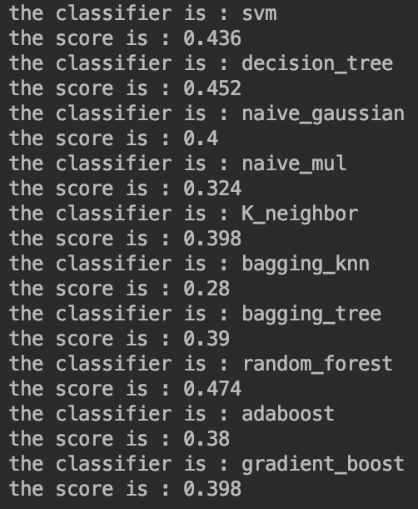
SUPERVISED LEARNING - CLASSIFICATION
Select classification algorithm
We used 500 of the more than 2,000 data as a test set. Through the training set, we used different algorithms to obtain the classification model results and scored the results. The results are as follows.
From the scoring we can see that the Random Forest score is the highest for the integration method, and the Bagging-Knn algorithm, which is also the integration method, has the lowest score. Therefore, our classification decided to use the Random Forest algorithm.

Slide 18
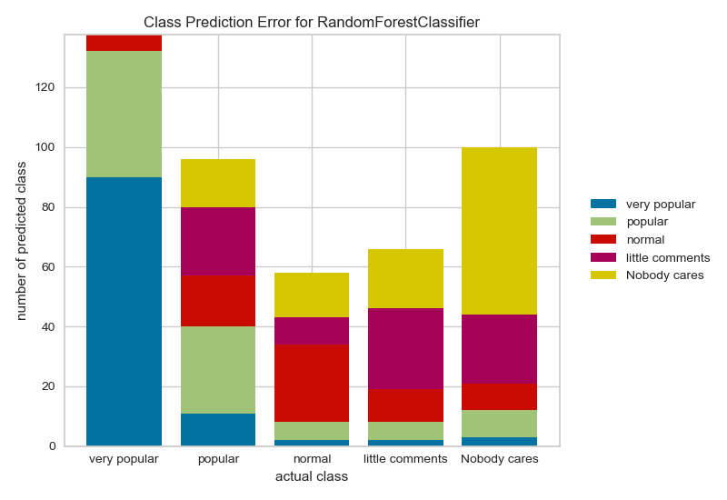
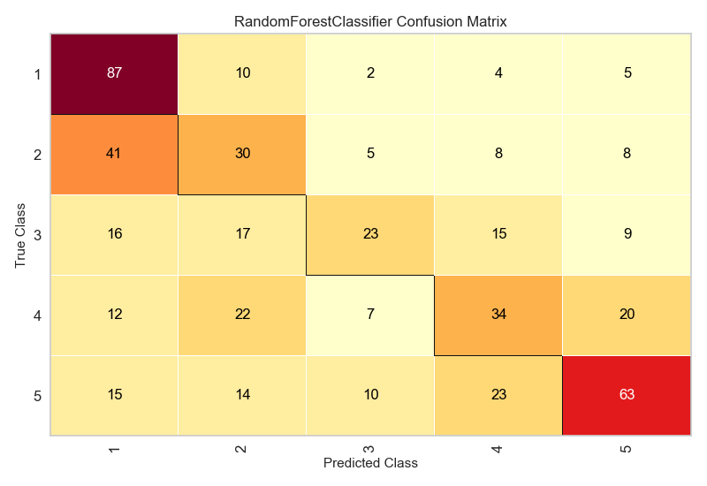
SUPERVISED LEARNING - CLASSIFICATION
TEST RESLUTS

Slide 19
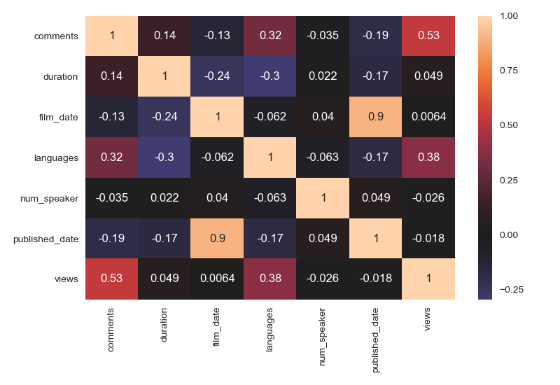
SUPERVISED LEARNING - REGRESSION
Looking for relevance
We can see that there is not much strong correlation between other attributes except for the obvious positive correlation (0.53) between views and comments. This also proves that we may not be able to produce perfect predictions, but we can try to go back. We ended up using duration, language and views to make regression predictions on comments.

Slide 20
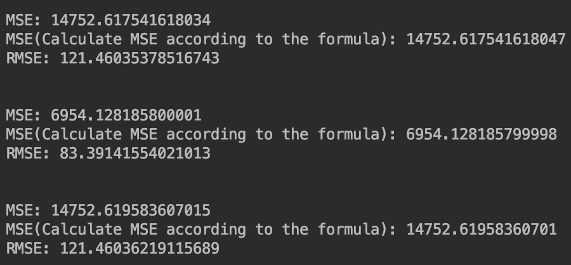
SUPERVISED LEARNING - REGRESSION
Try different
regression algorithms
We can see that the random forest algorithm in the middle obtains the smallest RMSE deviation, while the results of linear regression and ridge regression are not much different, and the results from the random forest algorithm have large errors. Therefore, we decided to use the random forest algorithm for regression prediction in the project.

Slide 21
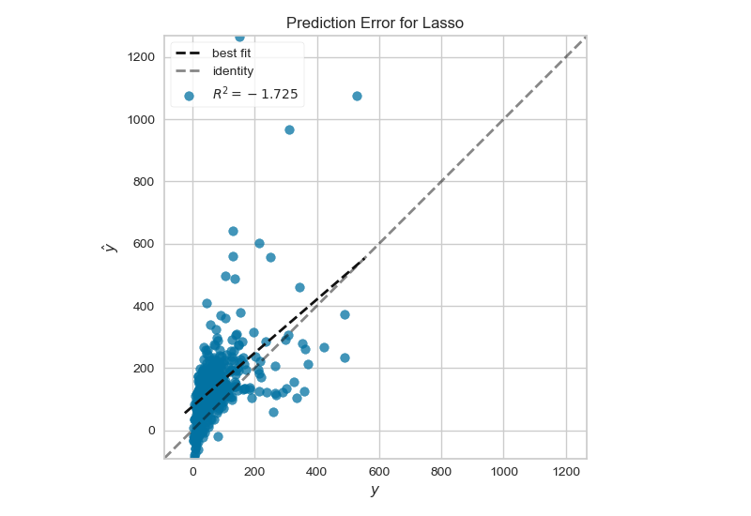
SUPERVISED LEARNING - REGRESSION
Lasso
We obtained the above image by regression analysis performed by the Lasso algorithm. Our data is almost concentrated near a straight line at a 45-degree angle, but the predicted values are a little larger than the true value. As you can see from the figure, the Lasso algorithm is more suitable for our sparse, irrelevant data, but because it is a biased estimate, we can't use it in real prediction.

Slide 22
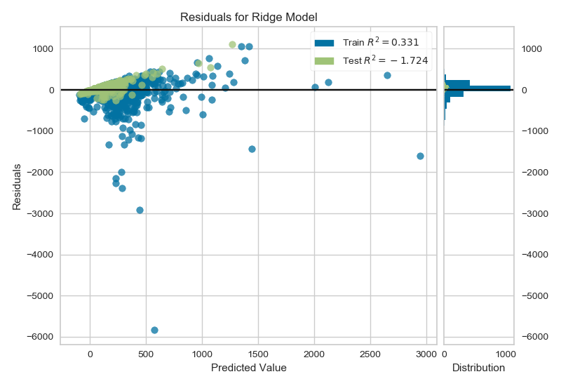
SUPERVISED LEARNING - REGRESSION
Ridge
Our training data is a blue point, and the test data is a green point. This figure shows the residuals between the test data and the training data. We see that the residuals of most of the test data are clustered around 0, indicating that our training model is more realistic.

